Slide 1

Coaching Corners and Safeties in 5th-8th Grade Tackle Football
Techniques, Alignments, and Drills for Youth Football
mcandrewsm@wiltonps.org

Slide 2
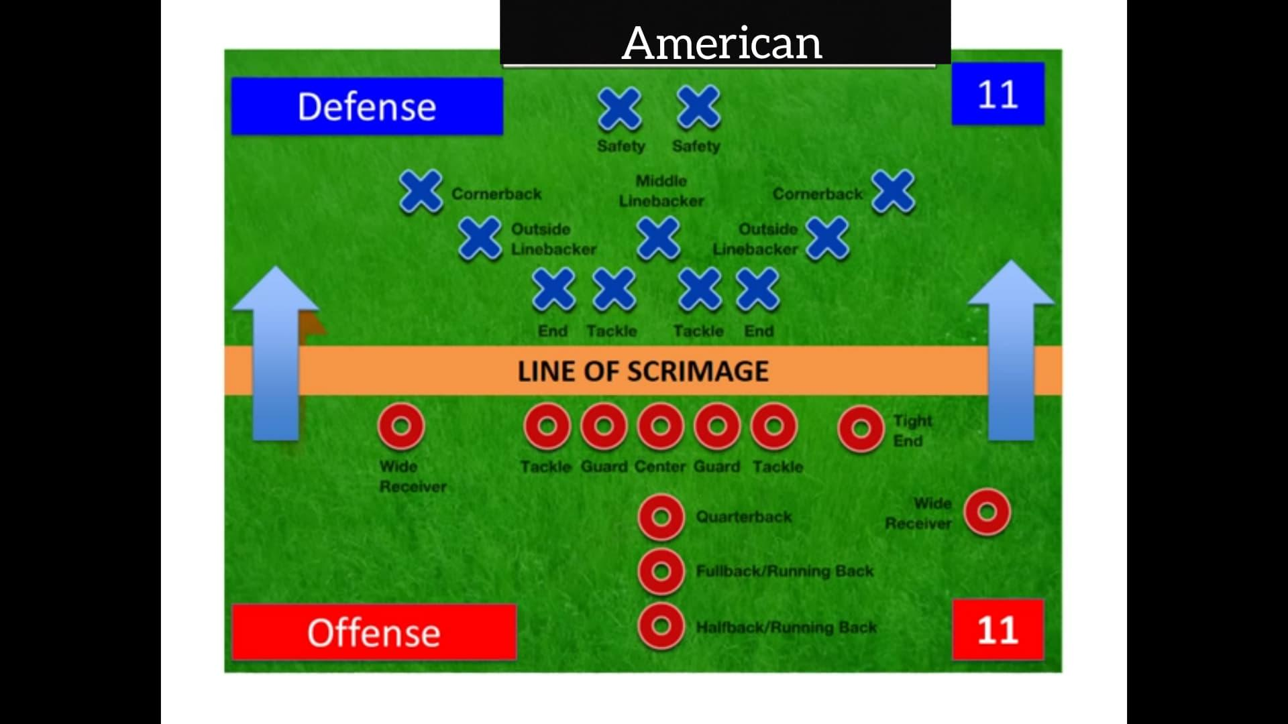
Why Focus on Defensive Backs?
My Goal:
  Help inform coaches proper fundamentals of building a strong defensive backs through drills and coaching points
Key Points:
  Importance of corners and safeties in youth football.
  Role in defending the pass and run. Learn to read both!!
  Overview of the presentation (stances, alignments, coverages, drills, how to run coverages out of 4-2-5).

Slide 3

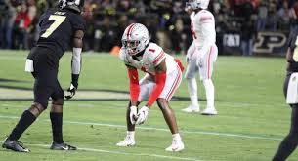
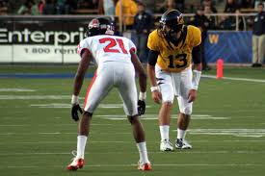
Stance Fundamentals
Proper Stance for Defensive Backs
Key Coaching Points:
  Feet shoulder-width apart, knees bent.
  Feet staggered??????
  Weight slightly forward on the balls of the feet.
  Hands loose and ready for movement.
Drill: "Mirror Drill" to practice staying low and balanced.
https://youtu.be/VUo-VQXgF54?feature=shared

Slide 4
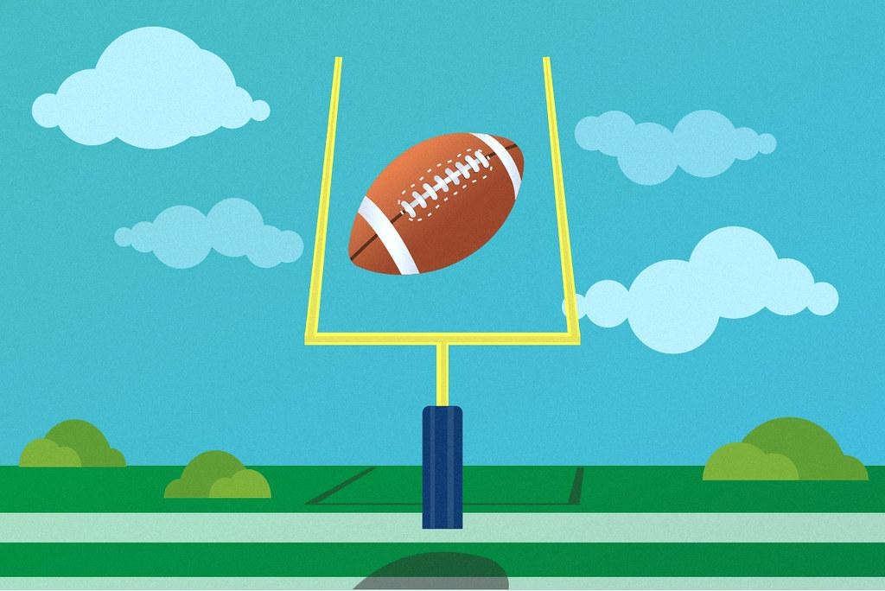
Backpedal Technique
Mastering the Backpedal
Key Coaching Points:
  Stay low with a slight forward lean.
  Short, controlled steps while maintaining balance.
  Eyes on the receiver or quarterback.
Drill:
  Straight and curved backpedal with change of speed
  "W Drill" for backpedal and change of direction.
https://youtu.be/j7m1Q_lrGj0?feature=shared https://youtu.be/90EMHdtB6ys?feature=shared

Slide 5
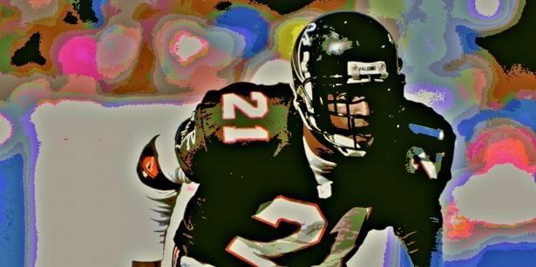
Hip Flip and Transition Drills
Opening hips smoothly
Transitioning from backpedal to sprint
Maintaining visual contact
Drill: Drill for transitions and hip flip
https://youtu.be/k65zPBOm_b8?feature=shared
https://youtu.be/L3IDQFBXrS8?feature=shared

Slide 6
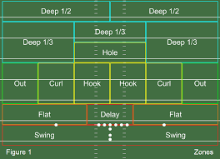
Zone coverage
AKA communication coverage
Breaking the field down into zones
Cover 4
Cover 3
Cover 2
Video: https://youtu.be/PdN7T_OzAKw?feature=shared

Slide 7
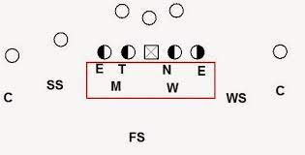
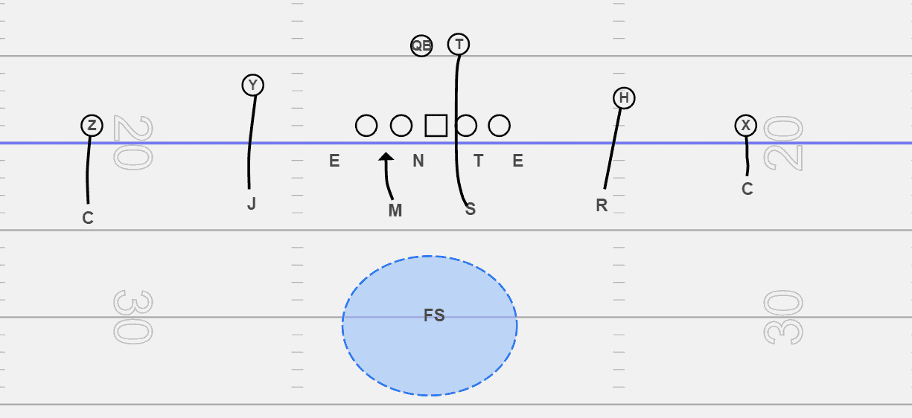
Man Coverage
Why play man?
The better your kids understand man responsibility
the more options you have to blitz
Who is blitzing and who has coverage?
When you need “silver” call?
Techniques
Pressing/Catching
Drills
https://youtu.be/UZY0RGKWfAY?feature=shared

Slide 8
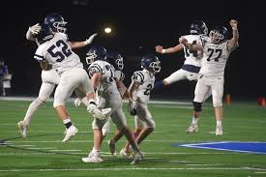
4-2-5 Defense: Alignment and Responsibilities

Slide 9
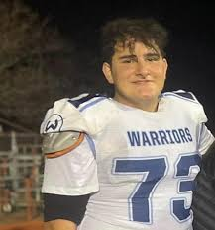
3-4-4 Defense: Alignment and responsibilities

Slide 10
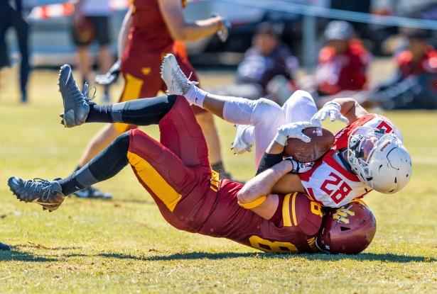
Defending the Run Fundamentals
https://youtu.be/yzxf98vrszk?feature=shared
Game Situation Practice
Reading formations
Route recognition
Quick reaction drills
Game speed scenarios

